Slide 1
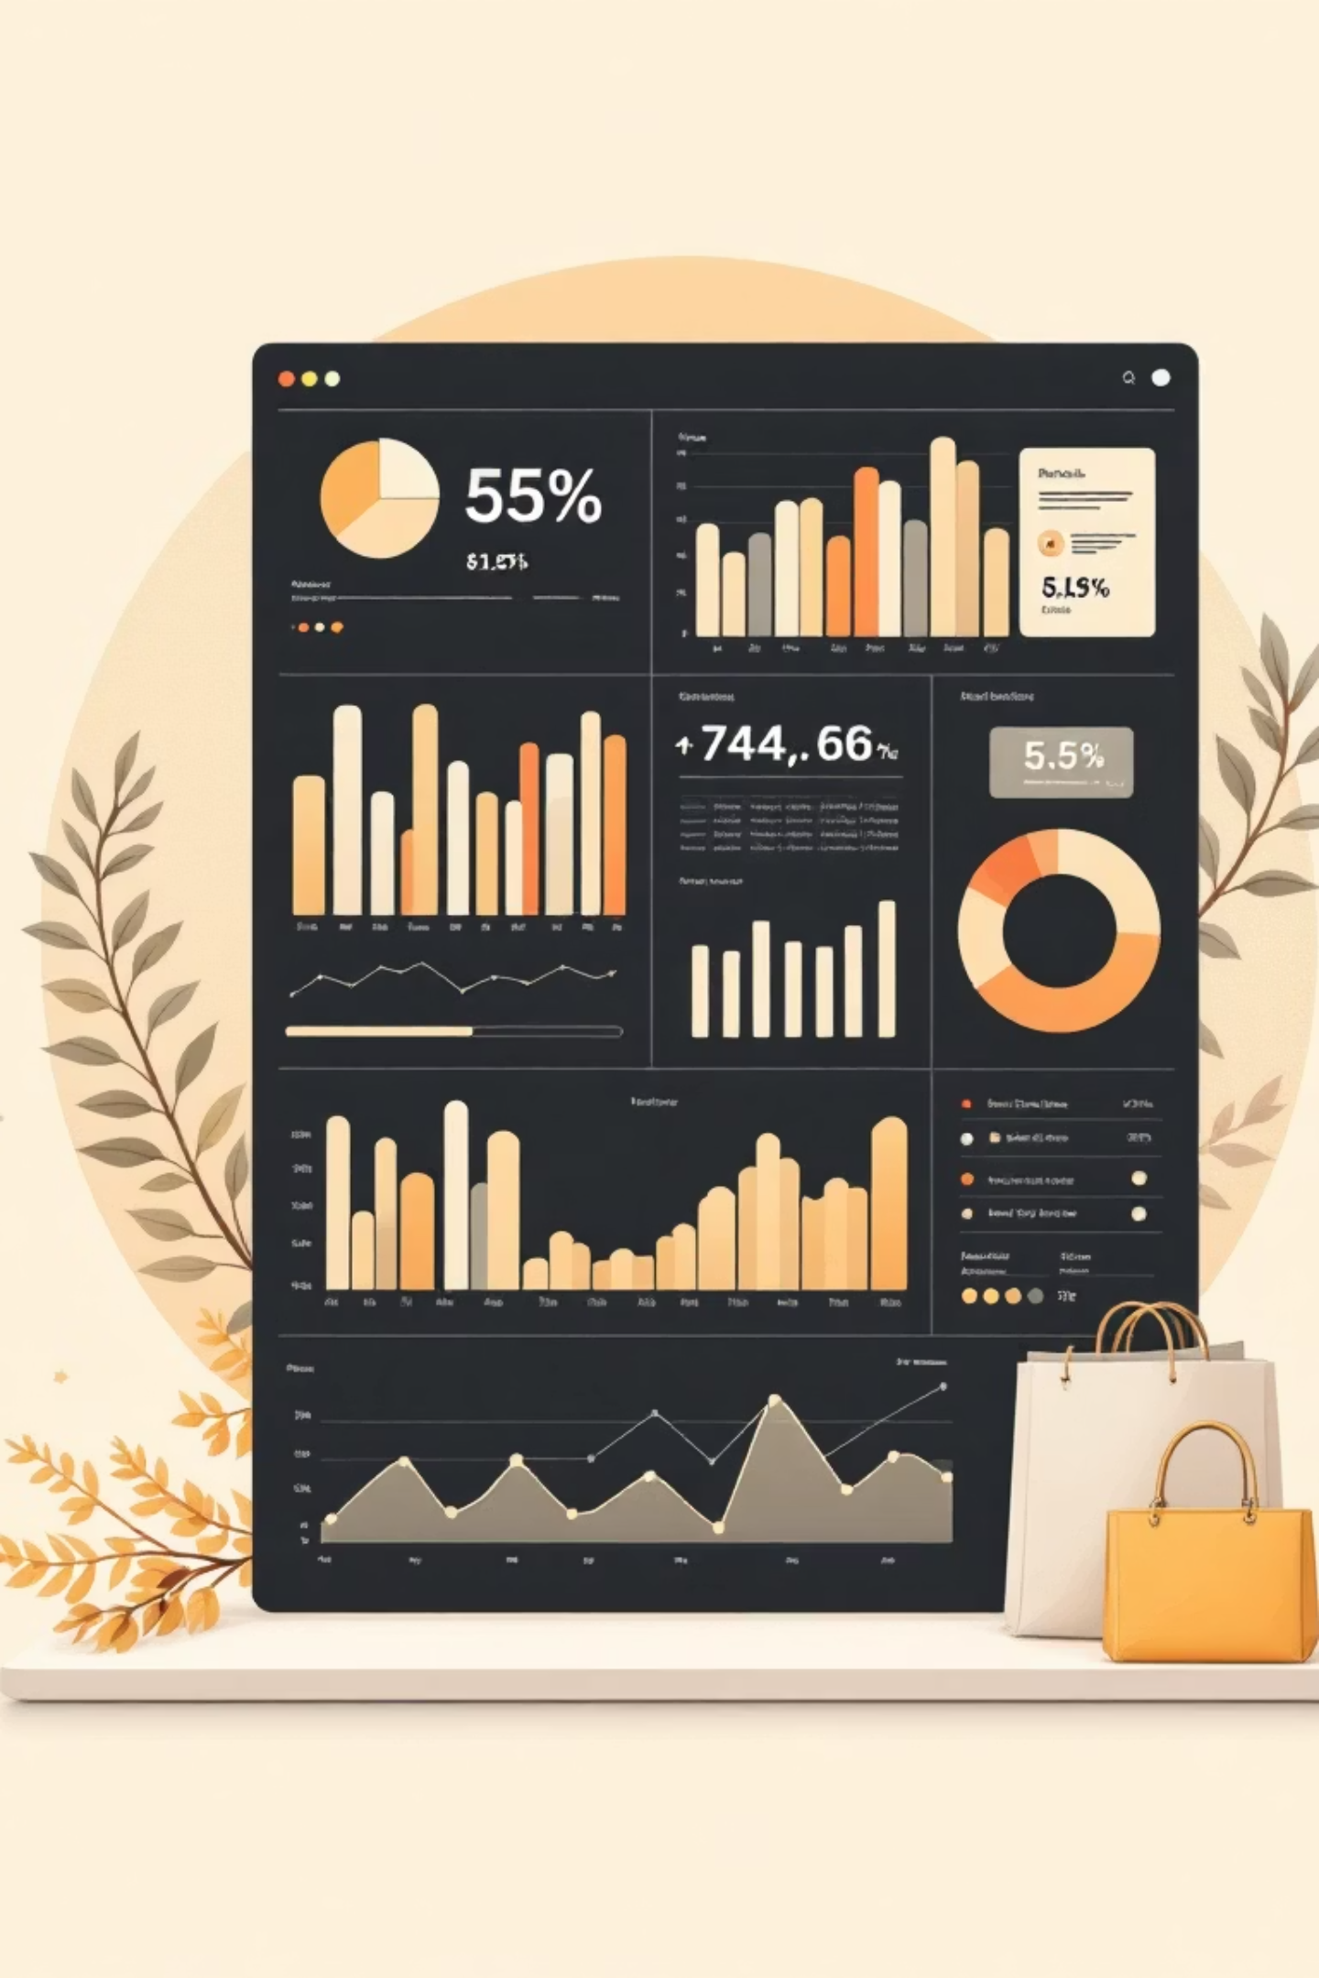
Customer Shopping Behavior Analysis
Understanding purchase patterns and customer preferences through data-driven insights. Uncovering insights to guide strategic business decisions

Slide 2
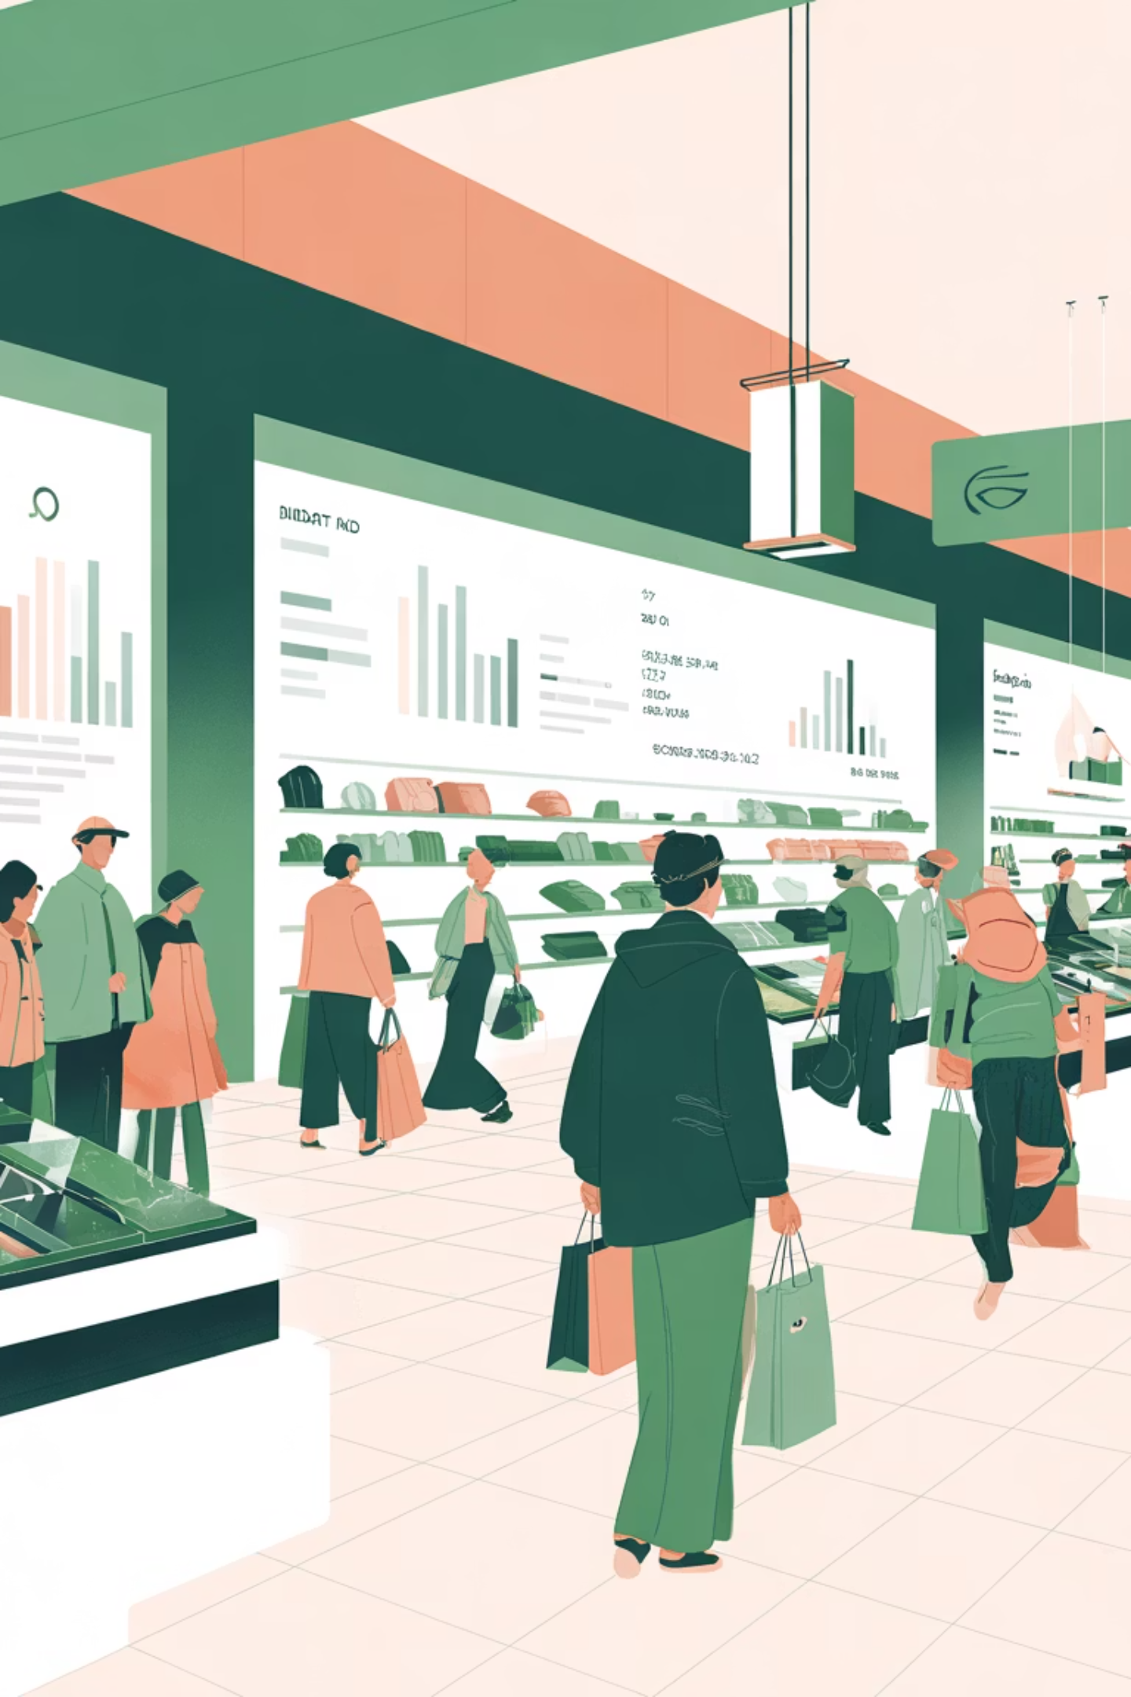
Project Overview
Our Focus
Business Impact
This project analyzes customer shopping behavior using 3,900 individual purchase transactions. We examine spending patterns across product categories, customer preferences, and subscription adoption to identify meaningful customer segments based on age, income, purchase frequency, and product choice.
The insights guide strategic decisions in marketing, pricing, product mix, and loyalty programs. By understanding customer preferences, high-performing categories, seasonal trends, and retention factors, we can increase engagement, repeat purchases, and overall business growth.

Slide 3

Business Objectives
Understand Customer Spending
Identify Customer Segments
Analyze spending allocation across product categories to identify high revenue contributors and low-performing segments
Group customers by demographics, purchase frequency, and preferences to build targeted marketing strategies
Evaluate Subscriptions
Enhance Retention
Study subscription adoption patterns and factors influencing decisions to optimize long-term revenue
Examine buying patterns and satisfaction drivers to improve retention and reduce customer churn

Slide 4

Dataset Overview
3,900
18
37
Total Purchases
Data Columns
Missing Values
Comprehensive transaction data
Customer demographics & behavior
Only in Review Rating column

Slide 5
Data Preparation Process
01
02
03
Data Loading
Initial Exploration
Missing Data Handling
Imported dataset using pandas
Structure check and summary statistics
Imputed Review Rating with median values
04
05
Feature Engineering
Database Integration
Created age groups and purchase frequency
Connected to PostgreSQL for analysis

Slide 6
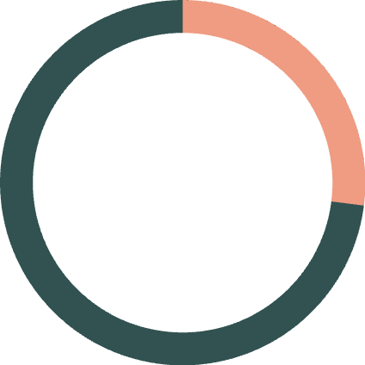
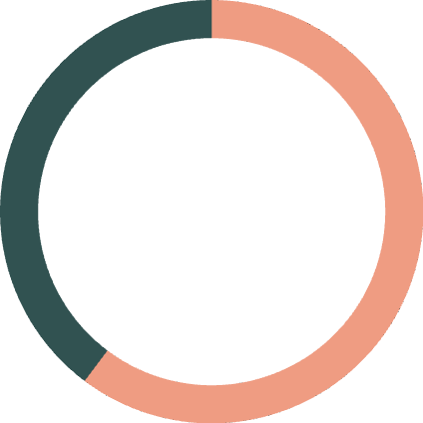

Customer Profile Insights
27%
$60.25
3.75
Subscription Rate
Female Avg Spend
Average Rating
Current subscribers with
73% conversion opportunity
Slightly higher than overall
average of $59.76
Moderate satisfaction with
room for improvement
Customer Demographics
Total customer base of 4,000 with diverse age groups and spending patterns. Young Adults emerge as the most profitable segment, followed by Middle-aged customers who show consistent engagement across all product categories.

Slide 7
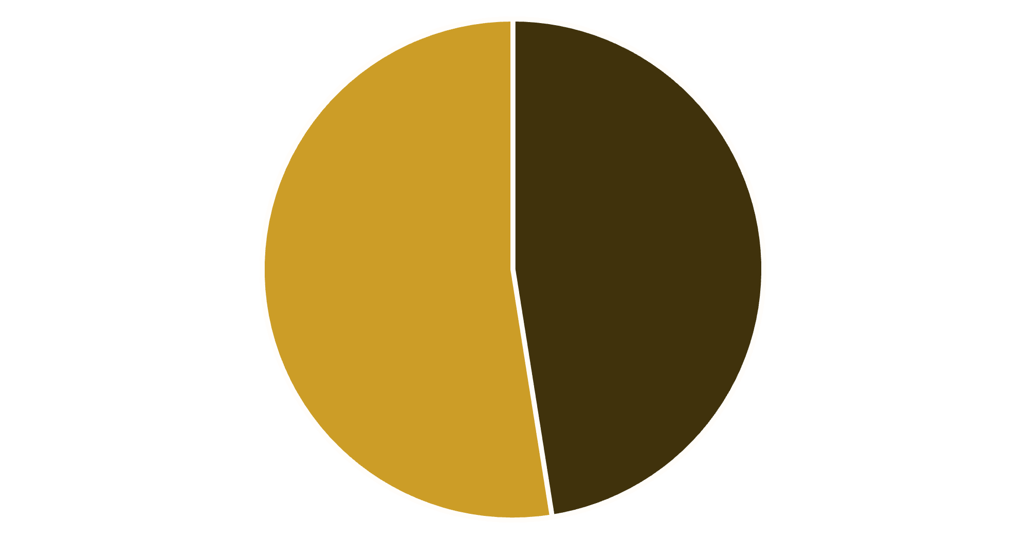

Revenue by Gender Analysis
Key Insight
Female customers generate slightly higher total revenue than male customers
Gender-based marketing strategies could optimize revenue streams
Male
Female

Slide 8
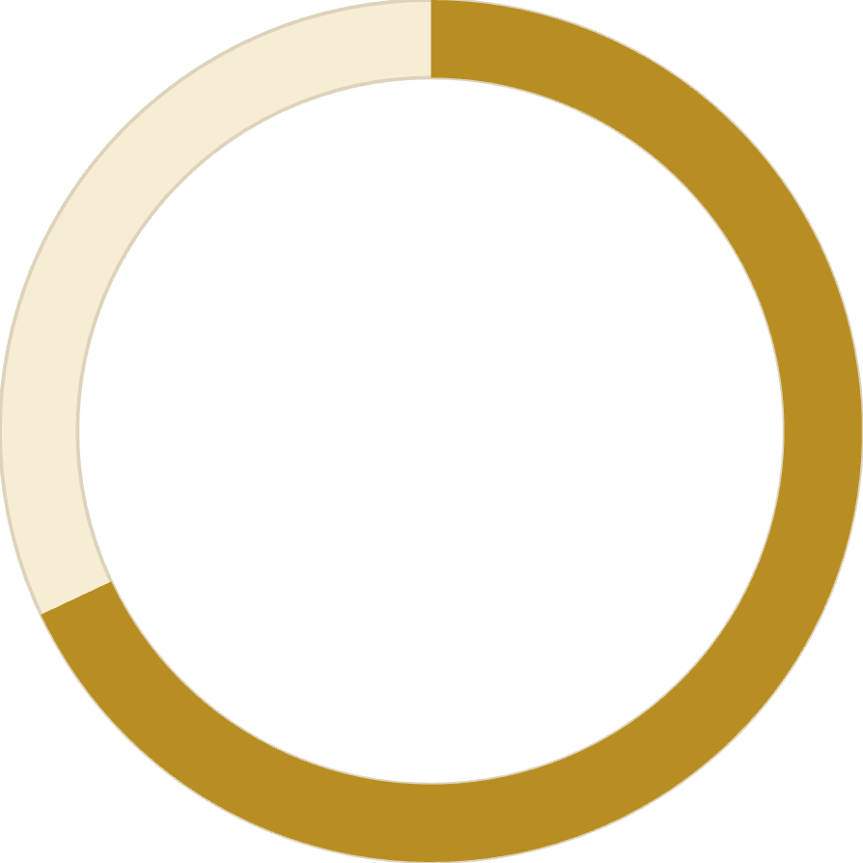
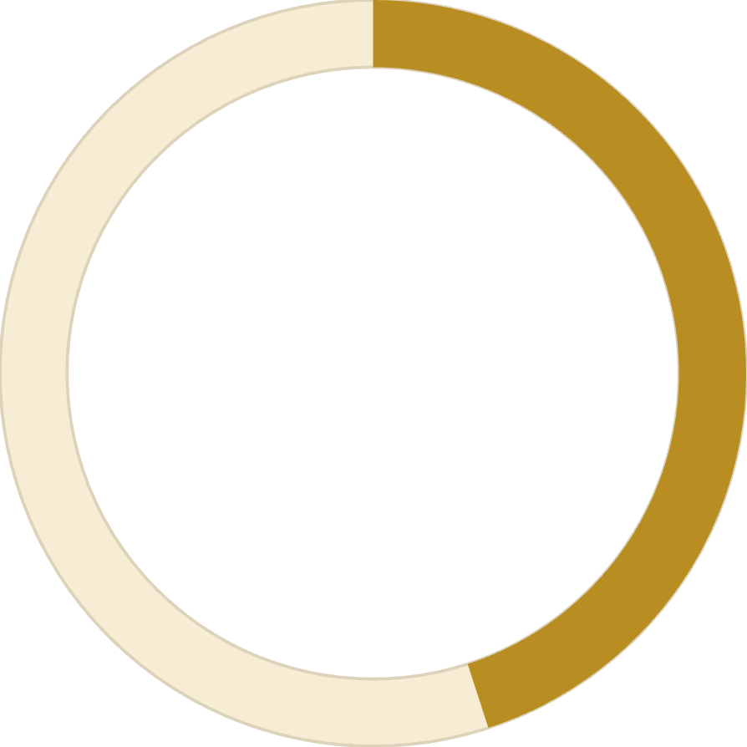
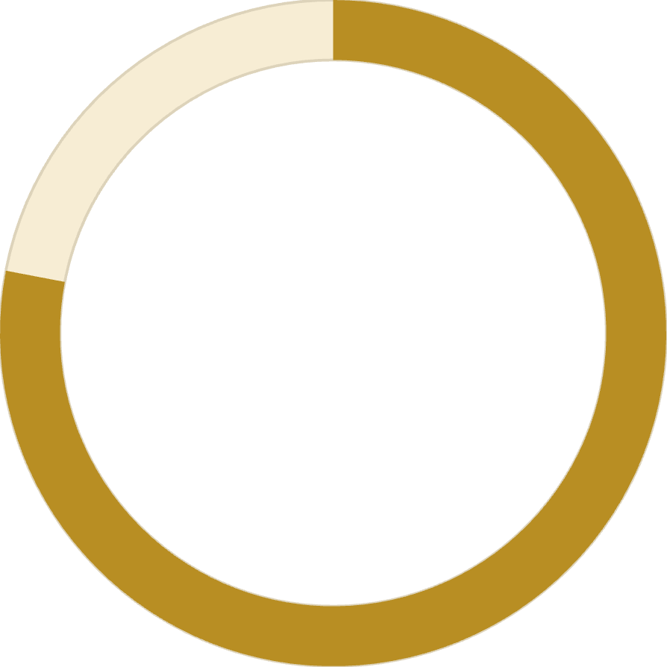
Subscription Impact
68%
45%
78%
Higher Spend
Revenue Share
Loyalty Rate
Subscribers vs non-subscribers
From subscription customers
Repeat purchase frequency

Slide 9

High-Value Discount Users
Customers using discounts while spending above average
Smart Shoppers
High spenders who maximize value with discounts
Strategic Opportunity
Target premium customers with exclusive offers

Slide 10
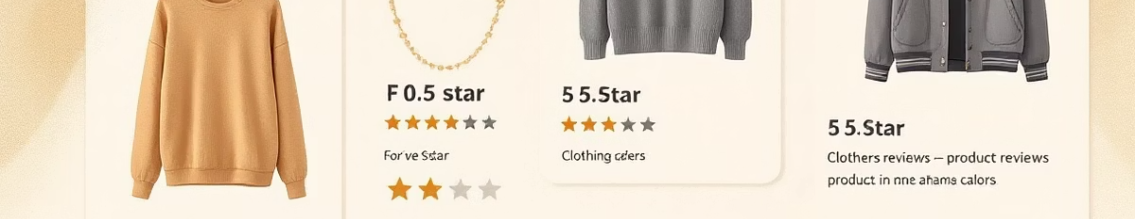


Top-Rated Products
5
5
4
Blouse
Dress
Shirt
Highest customer satisfaction
Consistently excellent reviews
Strong customer approval

Slide 11
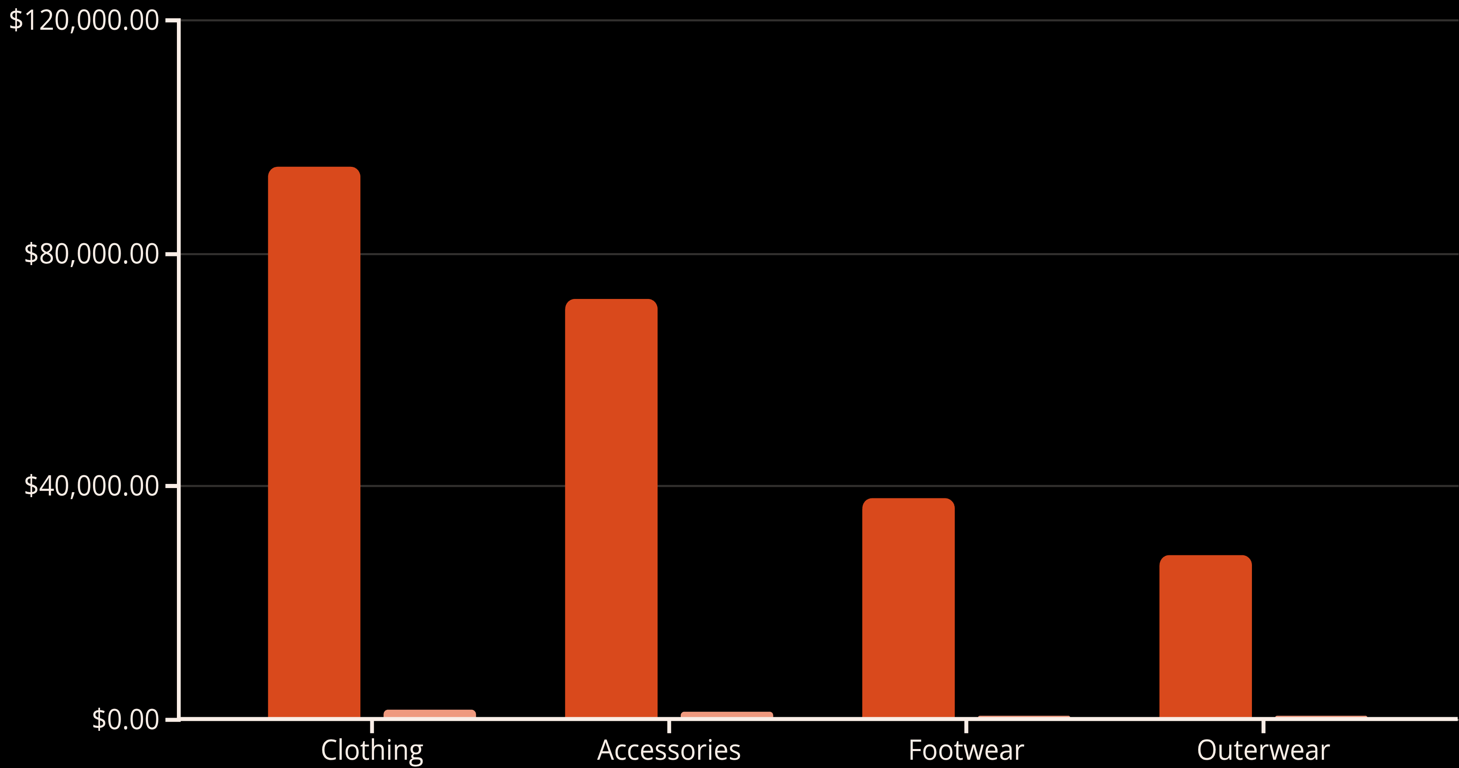
Product Category Performance
Clothing earns the highest revenue, making it he top-performing category.
Accessories follow, but there is a clear drop in revenue compared to Clothing.
Footwear and Outerwear show low sales and may need stronger marketing or product improvement.

Slide 12
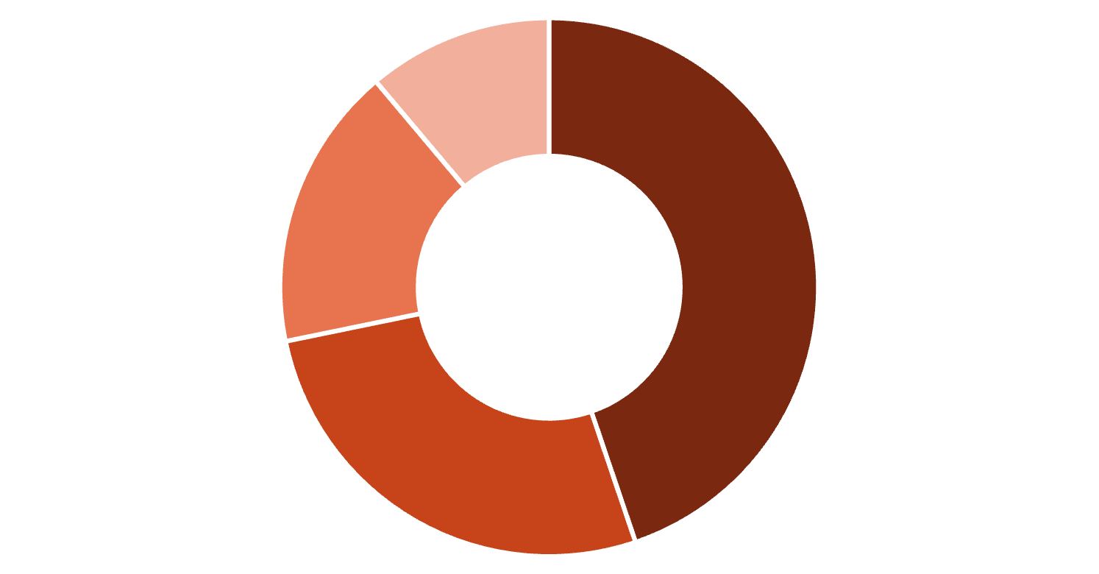
Seasonal & Size Preferences
Seasonal Sales Trends
Size Distribution
Sales peak in Spring, then steadily decline through Fall and Winter, reaching the lowest point in Summer. This pattern suggests need for aggressive summer promotions and leveraging spring momentum for new launches.
Spring
1
Peak sales period - highest revenue
2
Fall
Moderate performance
Winter
3
Medium
Large
Small
XL
Medium is most preferred (45%), followed by Large (27%). Inventory planning should prioritize M and L stock.
Declining trend
4
Summer
Lowest sales - needs intervention

Slide 13


Shipping Behavior
Free Shipping
Most preferred: Free Shipping leads across all age groups, especially Adults and Young Adults. Standard Shipping ranks second.
Store Pickup and
Next Day Air
2-Day and Express Shipping see lower usage, showing customers value savings over speed. Store Pickup and Next Day Air are least popular.

Slide 14

Shipping Preferences Impact
Express Shipping
Standard Shipping
$65
$58
Average purchase amount
Average purchase amount
Express shipping customers spend 12% more per transaction

Slide 15



Customer Segmentation
Loyal
1
15% - High value customers
Returning
2
35% - Regular shoppers
New
3
50% - First-time buyers
Focus on converting New to Returning, Returning to Loyal

Slide 16





Strategic Recommendations
Boost Subscriptions
Promote exclusive benefits for subscribers
Loyalty Programs
Reward repeat buyers to increase retention
Targeted Marketing
Focus on high-revenue segments and express users
Product Positioning
Highlight top-rated products in campaigns

Slide 17
Recommendations
Seasonal Strategy
Enhance Experience
Launch aggressive summer promotions and leverage spring momentum for new product launches and subscription campaigns
Lift ratings from 3.75 to 4.2+ through quality improvements and better support
Revive Low Performers
Delivery Excellence
Maintain Free Shipping as core offering with minimum purchase thresholds to increase basket size and customer satisfaction
Improve Footwear and Outerwear through seasonal promotions and product bundling

